Slide 1
Machine Learning
MATH42815
Monday April 22nd 2024

Slide 2
MEQ Feedback
Thank you all so much for filling in the MEQ form!
Your feedback warmed my heart and gave me helpful ideas going forward
Common points:
Needed more time, both in terms of number of contact hours and spacing between sessions
Unsure how to access slides in original format
Need to provide solutions to workshops (yes, and that is one of the things I will be focused on this term)
Requests for real-world data examples
Mostly boring, complicated, or depressing

Slide 3
Bonus Workshop 1
Support Vector Machines
Interactive Learning Experience
Kernel Trick

Slide 4
Support Vector Machines

Slide 5
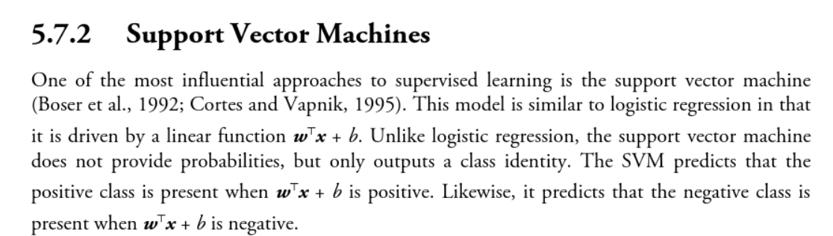
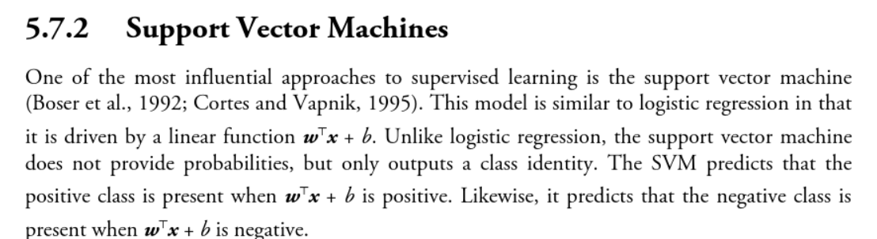
What is a Support Vector Machine?
Deep Learning, Goodfellow et al.

Slide 6
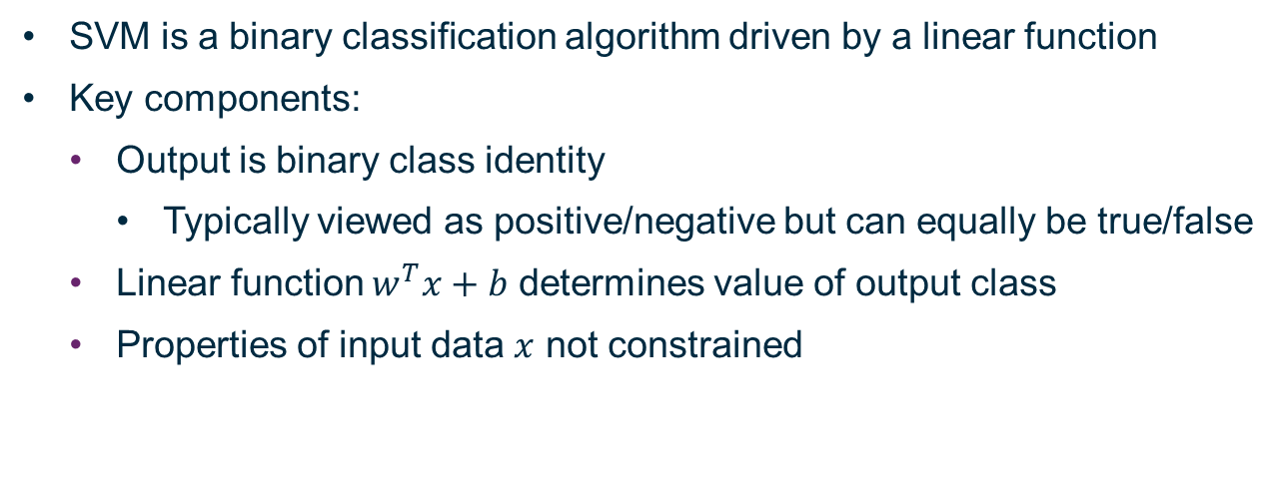
What Does That Mean?
SVM is a binary classification algorithm driven by a linear function
Key components:
Output is binary class identity
Typically viewed as positive/negative but can equally be true/false
Linear function $w^{T}x+b$ determines value of output class
Properties of input data $x$ not constrained

Slide 7
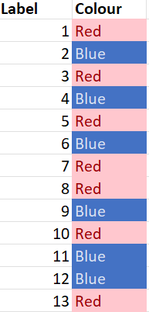
Divide the Shapes Into Two Groups
3
5
1
4
2
7
6
10
12
8
9
11
13

Slide 8
Dummy Variable Dimension for Colour
1
3
5
7
8
10
13
2
4
6
9
11
12
Red
Blue
Colour

Slide 9
Example: Dummy Variables vs. One-Hot Coded
Age | <18 | 65+
18-64 | 0 | 0
<18 | 1 | 0
18-64 | 0 | 0
65+ | 0 | 1
18-64 | 0 | 0
Age | <18 | 18-64 | 65+
18-64 | 0 | 1 | 0
<18 | 1 | 0 | 0
18-64 | 0 | 1 | 0
65+ | 0 | 0 | 1
18-64 | 0 | 1 | 0

Slide 10
One Hot Coded Dimension for Colour
1
3
5
7
8
10
13
2
4
6
9
11
12
Red
0
1
Blue
1

Slide 11
What Happens If The Shapes Get More Complicated?

Slide 12
DOG! OR! NOT!!!!
DOG!
DOG! OR!

Slide 13


Slide 14
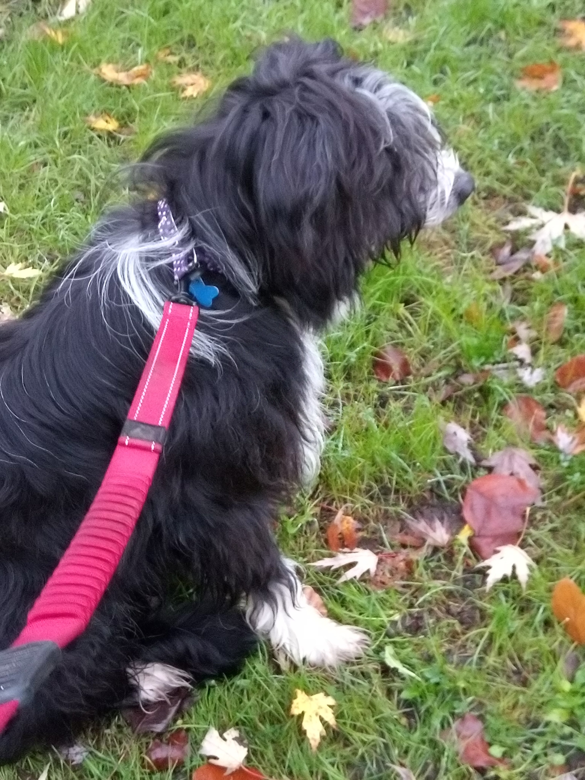

Slide 15
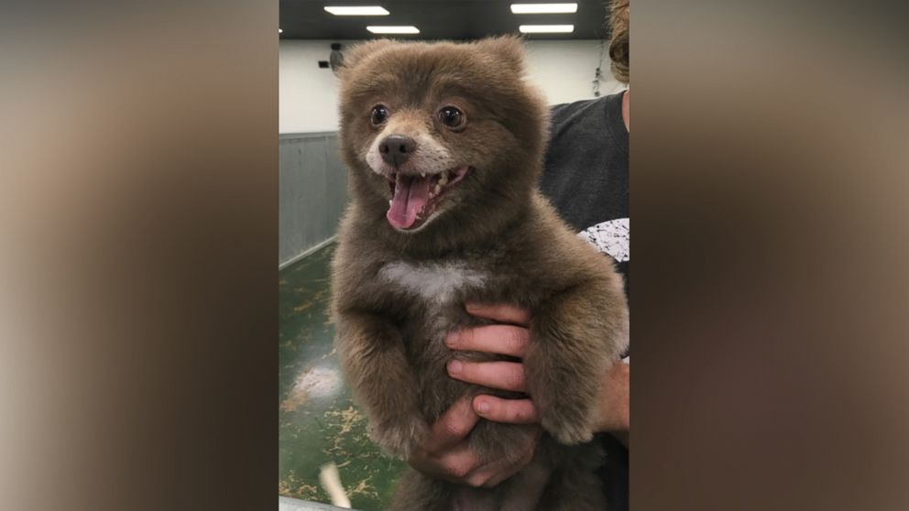

Slide 16
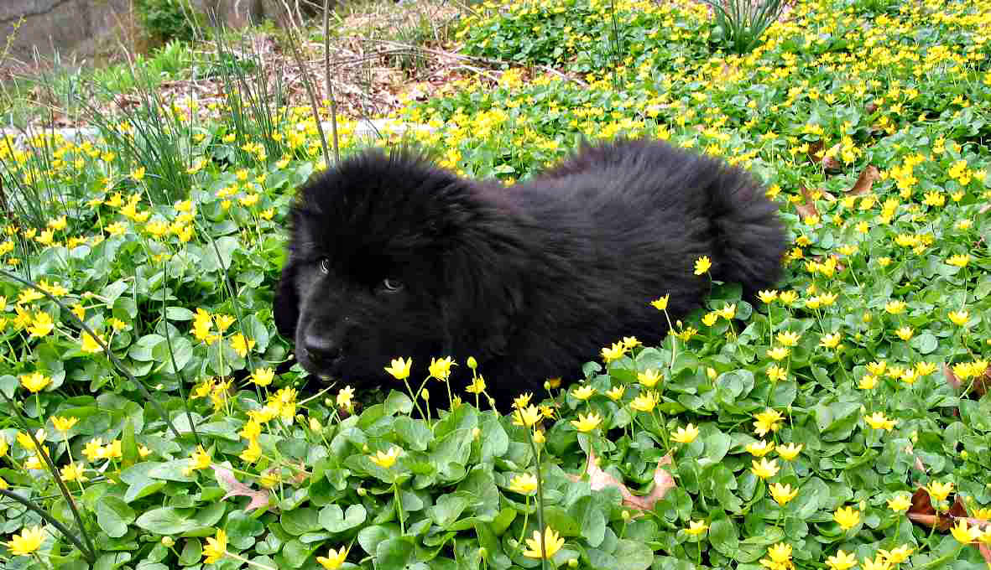

Slide 17


Slide 18
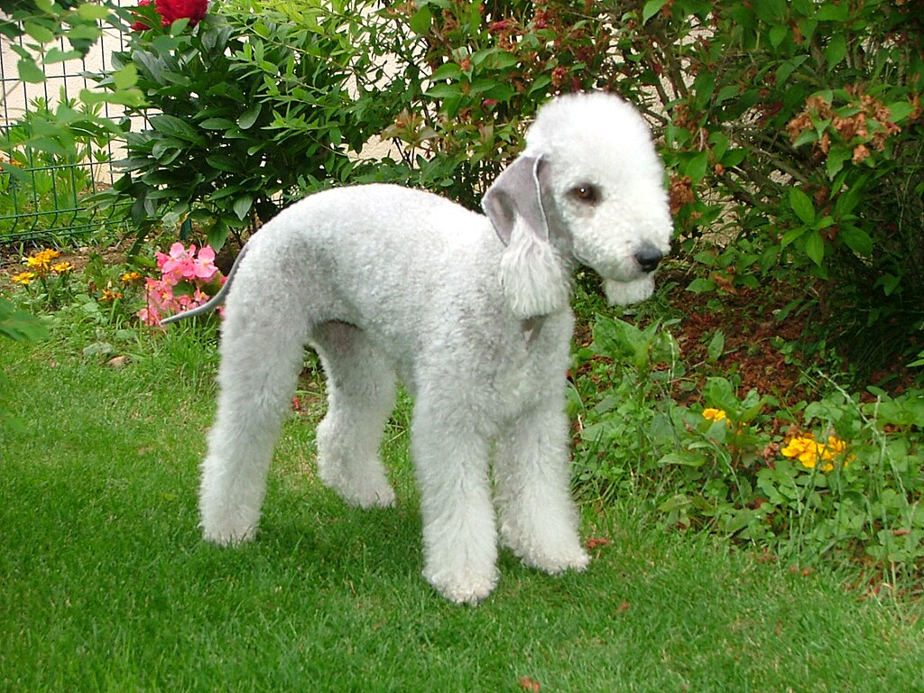

Slide 19
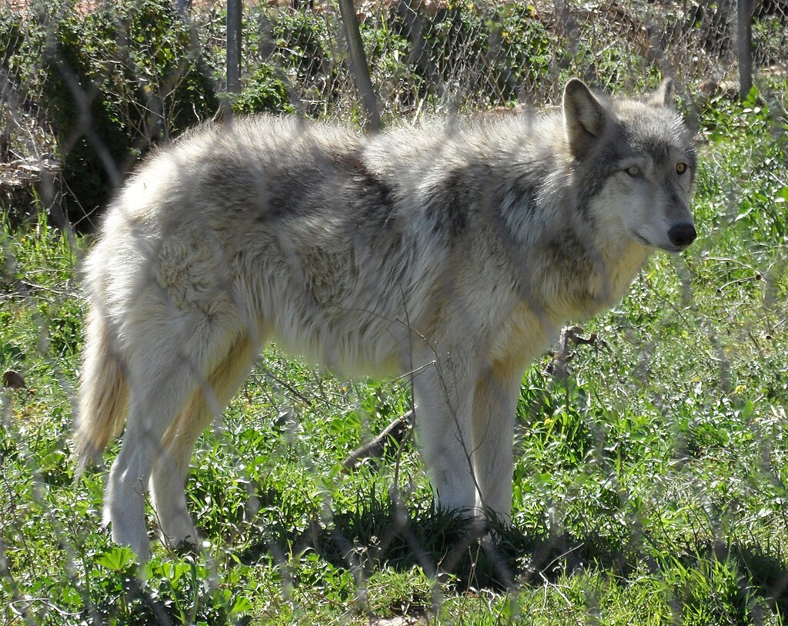

Slide 20


Slide 21
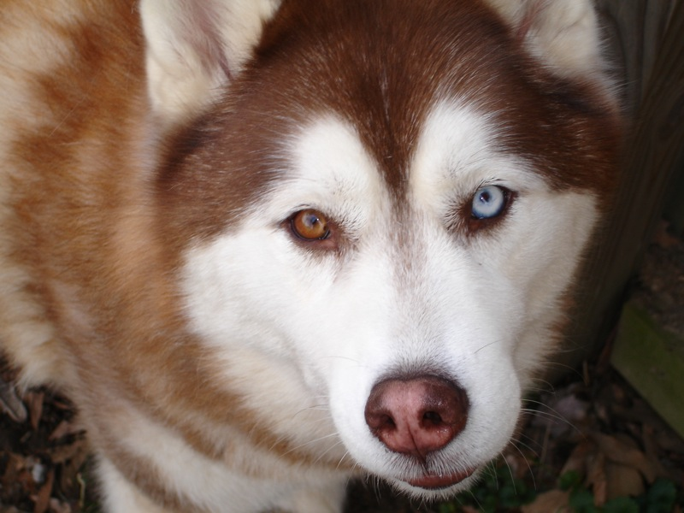

Slide 22
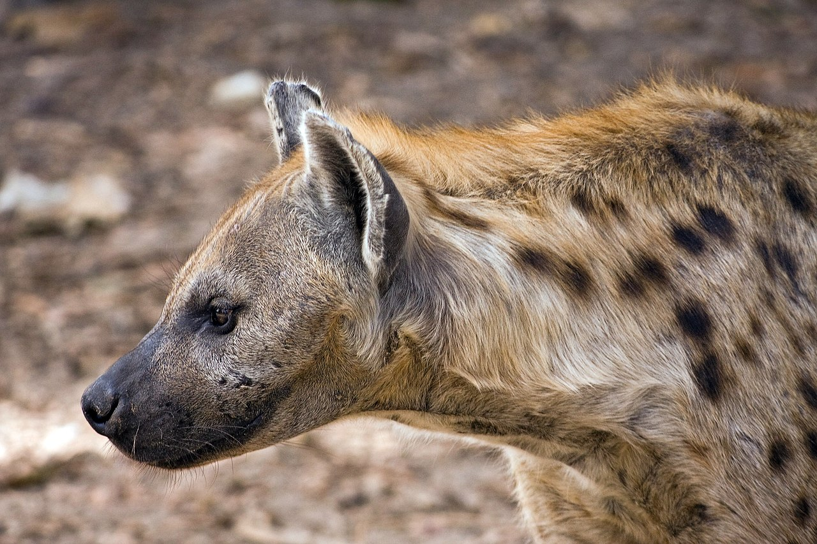

Slide 23
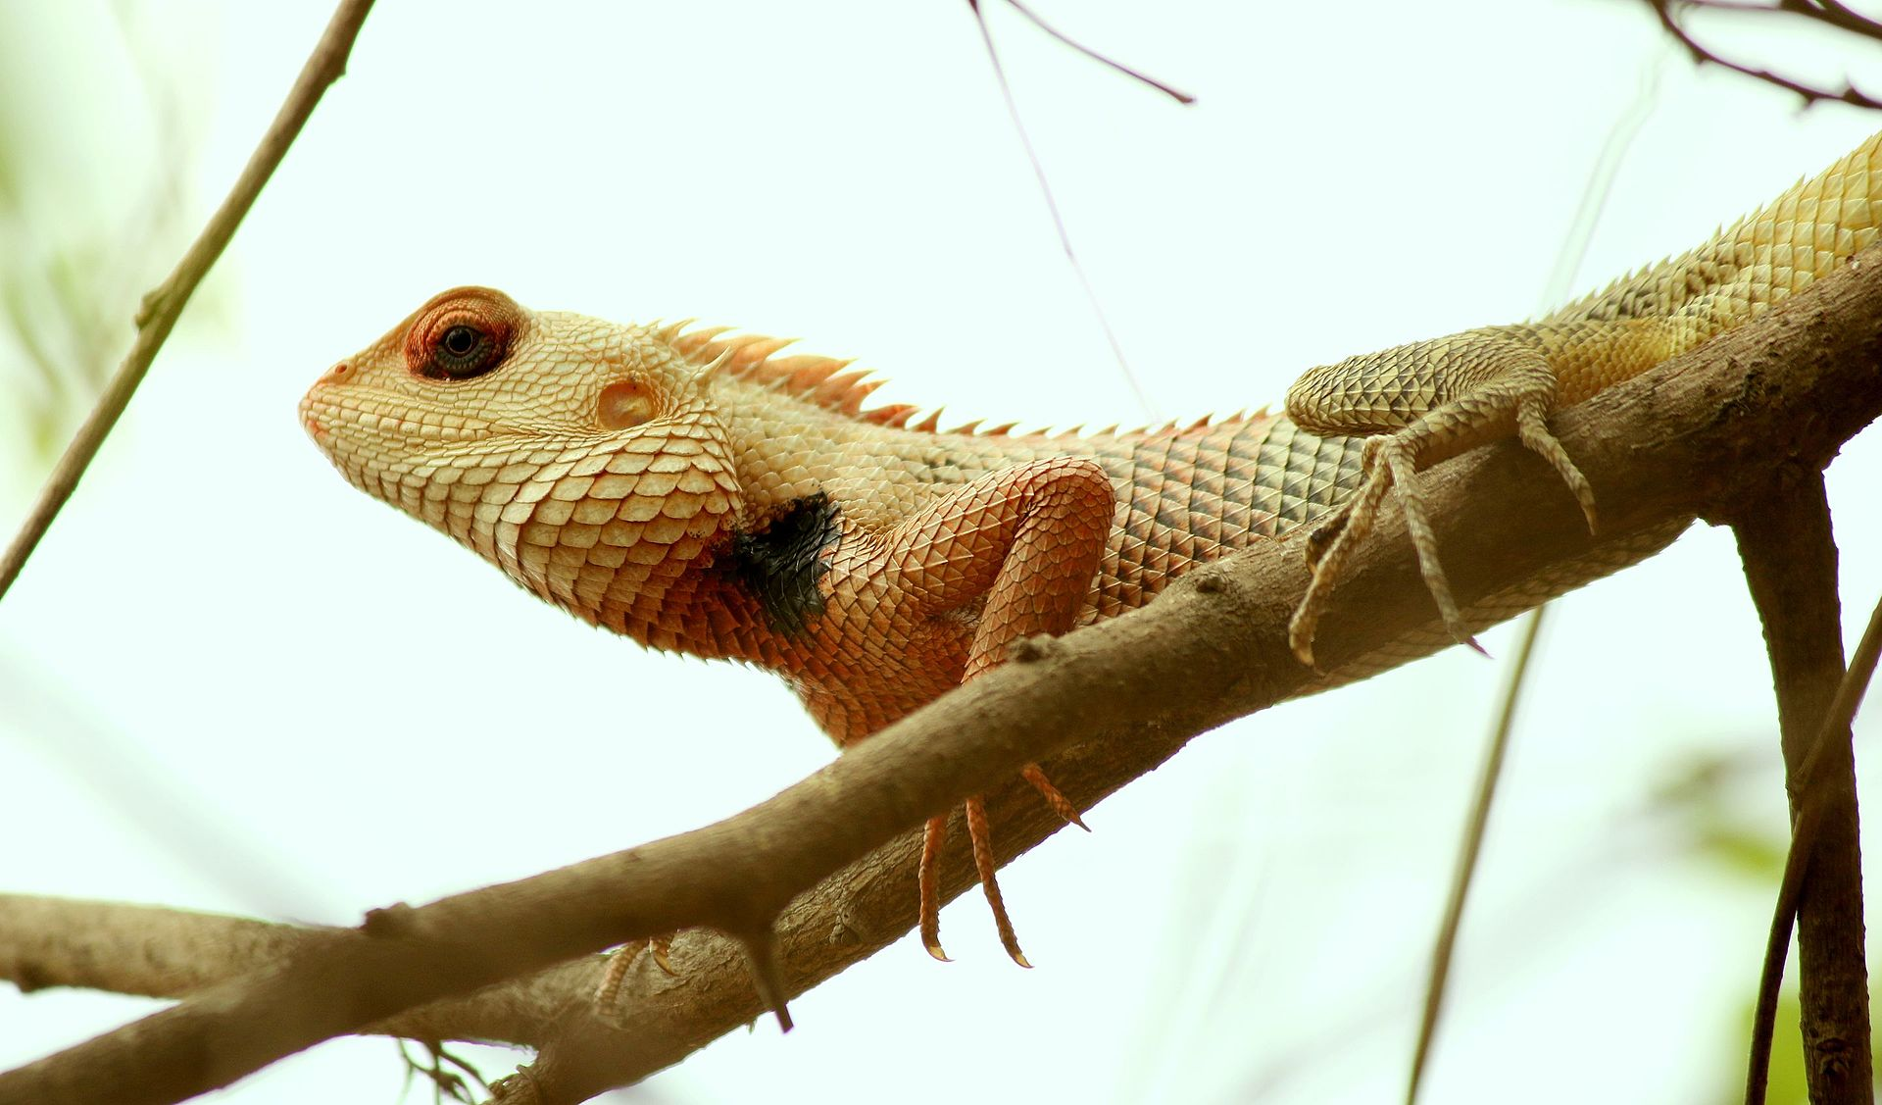

Slide 24
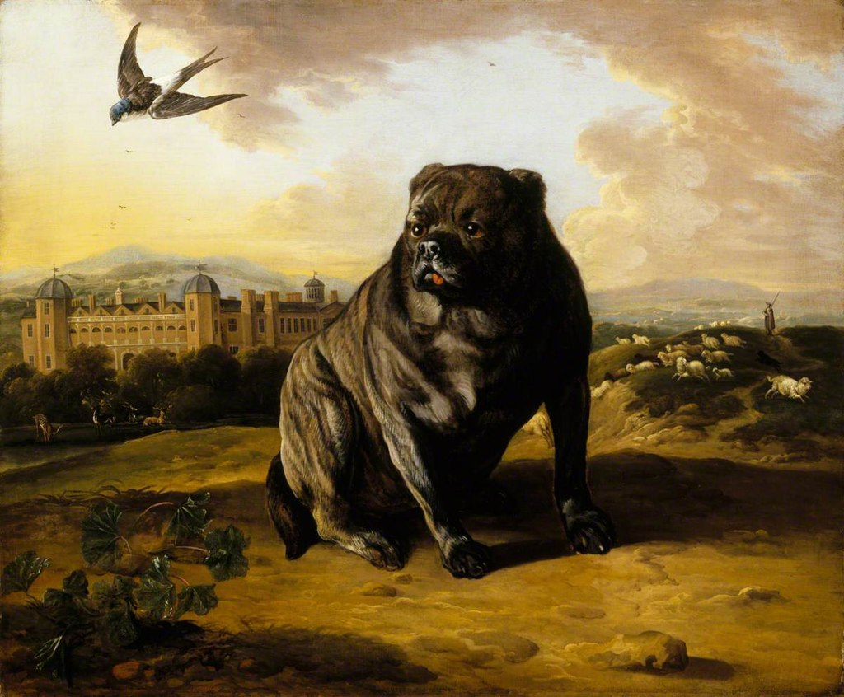

Slide 25
Back to SVM…

Slide 26
What Happens If The Shapes Get More Complicated?

Slide 27
Categorical versus Continuous*
Large
Medium
Circles
Stars
Small
Red
Green
Blue
*N.B. This is not a complete taxonomy of data types!

Slide 28
What Is Colour?
Human eyes have receptors that peak at three different frequencies: red, green, and blue
The amount of light hitting your eye at (around) each of those frequencies determines the colour
On computer screens, we usually define the amount of each of those colours with an integer between 0 and 255 (but we can divide by 255 to create a scale between 0 and 1)
Colour | Red | Green | Blue
Red | 255 / 1 | 0 / 0 | 0 / 0
Blue | 0 / 0 | 115 / 0.45 | 207 / 0.81
Green | 146 / 0.57 | 208 / 0.82 | 80 / 0.31

Slide 29
Size | Shape | Red | Green | Blue
1.2 | 0 | 0.0 | 0.45 | 0.81
1.2 | 0 | 0.57 | 0.82 | 0.31
1.2 | 1 | 1.0 | 0.0 | 0.0
2.7 | 0 | 0.0 | 0.45 | 0.81
2.7 | 0 | 0.0 | 0.45 | 0.81
2.7 | 0 | 0.0 | 0.45 | 0.81
2.7 | 0 | 1.0 | 0.0 | 0.0
2.7 | 0 | 1.0 | 0.0 | 0.0
2.7 | 0 | 1.0 | 0.0 | 0.0
2.7 | 1 | 0.0 | 0.45 | 0.81
4.5 | 0 | 1.0 | 0.0 | 0.0
4.5 | 1 | 0.57 | 0.82 | 0.31

Slide 30
What “Dimensions” Indicate Dog Or Not?
Default number of legs = 4
Ear shape and size
Paws (not e.g. hooves)
Mammal (indicated by fur)
Domesticated (indicated by leash, context clues like sink)
Approximate size (smaller than building)
Measure the value of these “dimensions” and classify a given creature
More on this concept in Friday’s session

Slide 31
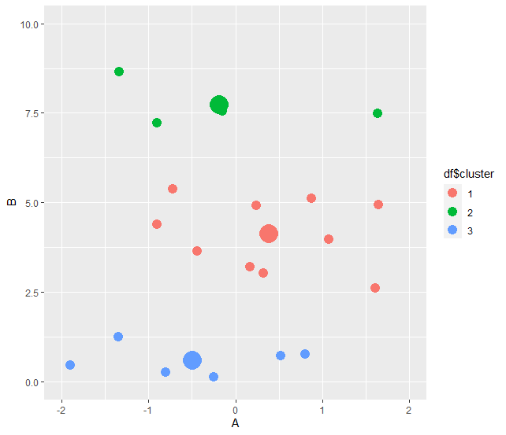
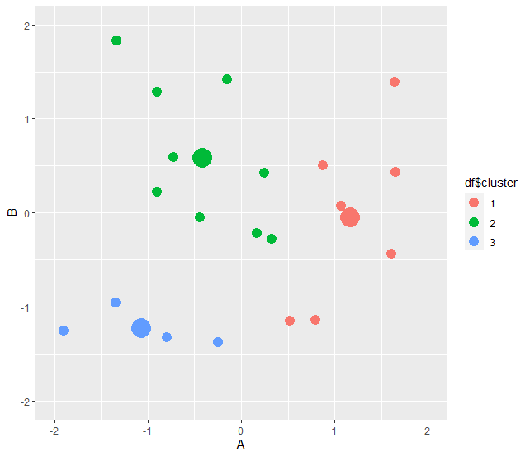
What Happens If You Forget To Normalise?
Notes:
If you are classifying children by age AND height, and you want to identify children who are tall for their age, you need to account for both variables or you will just label all the older children as tall.

Slide 32

What Does That Mean?
SVM is a binary classification algorithm driven by a linear function
Key components:
Output is binary class identity
Typically viewed as positive/negative but can equally be true/false
Linear function $w^{T}x+b$ determines value of output class
Properties of input data $x$ not constrained
$$\left.\begin{matrix}\text{"}\text{Negative}\text{"}, \text{i}\text{f} w^{T}x+b<0 \\ \text{"}\text{Posi}\text{tive}\text{"}, \text{i}\text{f} w^{T}x+b>0\end{matrix}\right\}$$

Slide 33
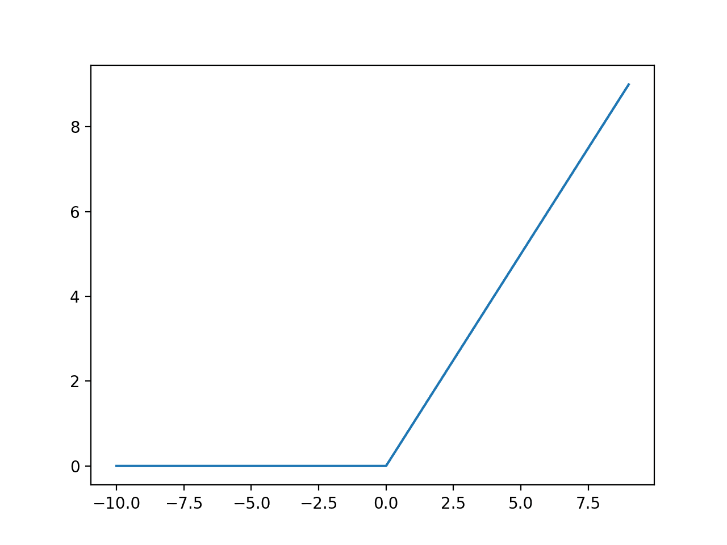
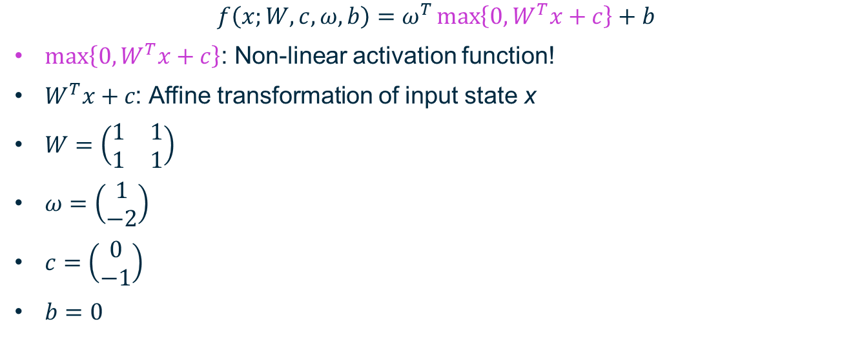

Neural Network to Reproduce XOR
$$f\left(x;W,c,ω,b\right)=ω^{T}\max\left\{0,W^{T}x+c\right\}+b$$
$\max\left\{0,W^{T}x+c\right\}$: Non-linear activation function!
$W^{T}x+c\text{: }$Affine transformation of input state x
$W=\left(\begin{matrix}1 & 1 \\ 1 & 1\end{matrix}\right)$
$ω=\left(\begin{matrix}1 \\ −2\end{matrix}\right)$
$c=\left(\begin{matrix}0 \\ −1\end{matrix}\right)$
$b=0$
Combined: hidden layer!

Slide 34
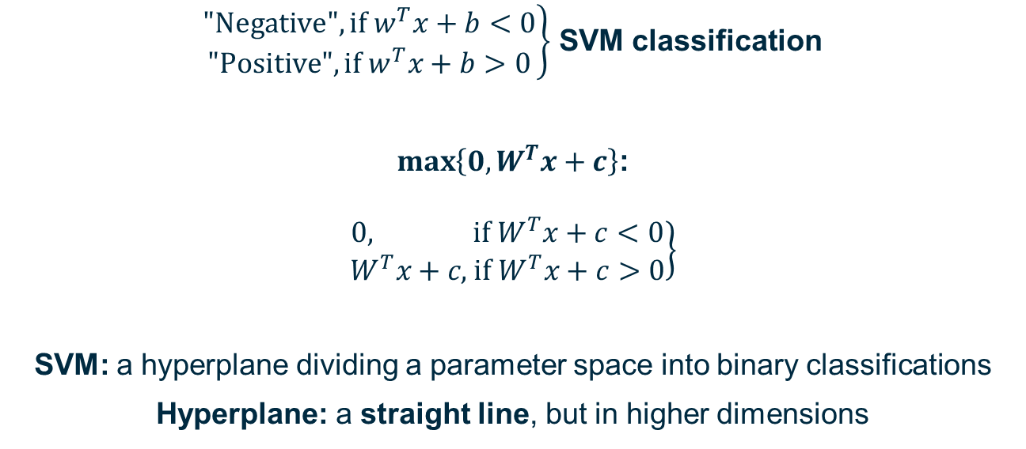
The XOR example contains an SVM (kind of)
$\left.\begin{matrix}\text{"}\text{Negative}\text{"}, \text{i}\text{f} w^{T}x+b<0 \\ \text{"}\text{Positive}\text{"}, \text{i}\text{f} w^{T}x+b>0\end{matrix}\right\}$ SVM classification
$\max\left\{0,W^{T}x+c\right\}$:
$$\left.\begin{matrix}0, \text{i}\text{f} W^{T}x+c<0 \\ W^{T}x+c\text{,} \text{if} W^{T}x+c>0\end{matrix}\right\}$$
SVM: a hyperplane dividing a parameter space into binary classifications
Hyperplane: a straight line, but in higher dimensions

Slide 35
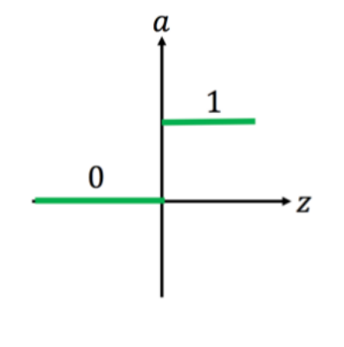
Perceptrons
Binary output – TRUE or FALSE, 1 or 0, something did or didn’t happen
Affine Transformation:
Multiply feature variables x_{j} by weights w_{j}
Sum over j
Activation function:
If result of affine transformation is greater than some minimum (“threshold” = -b) value, output is 1 / TRUE / the thing happened
Otherwise output is 0
This represents step function – can use sigmoids etc. to calculate probabilities instead of binary step
Step happens at 0 if you include +b in affine transformation sum

Slide 36
Okay, So What Did That Student Mean By “Support Vector Machines”?

Slide 37
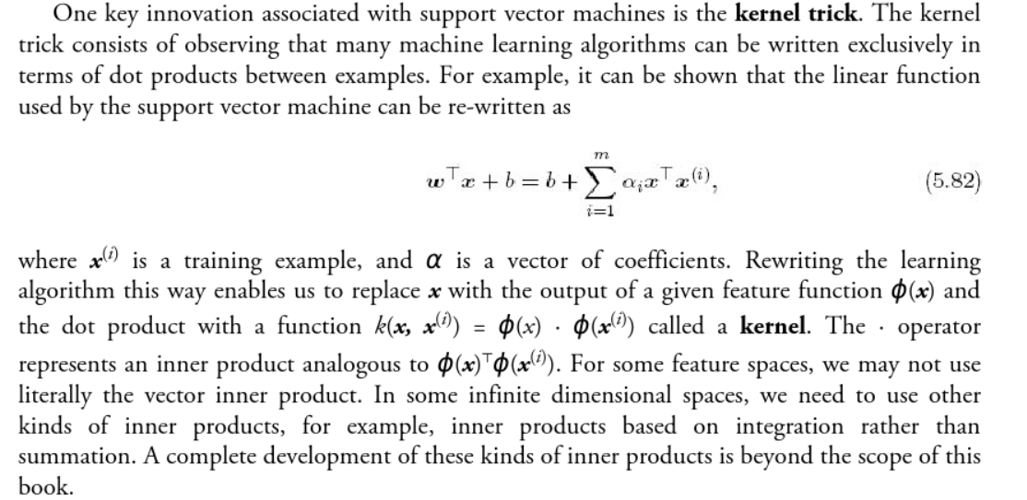
I’m Pretty Sure They Meant The Kernel Trick
Deep Learning, Goodfellow et al.

Slide 38
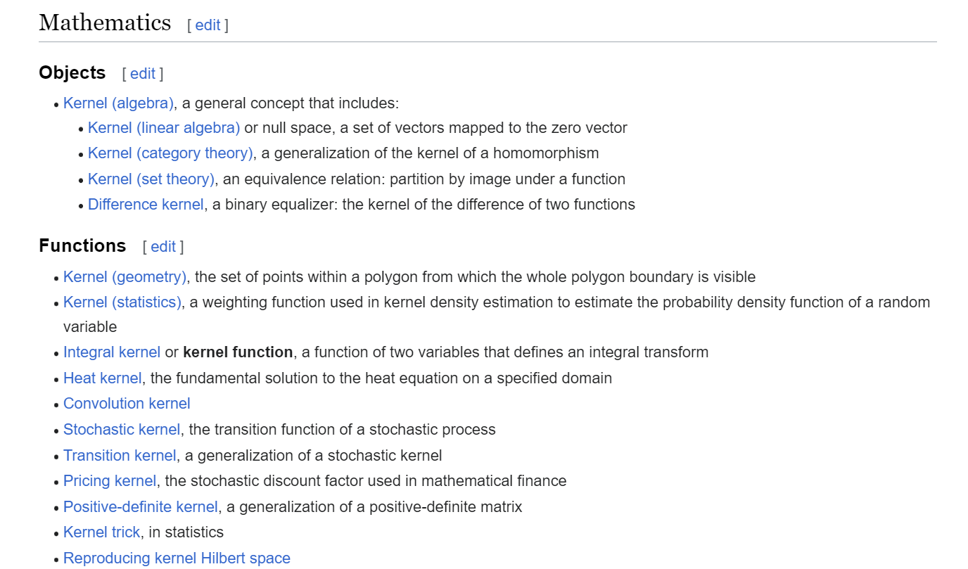
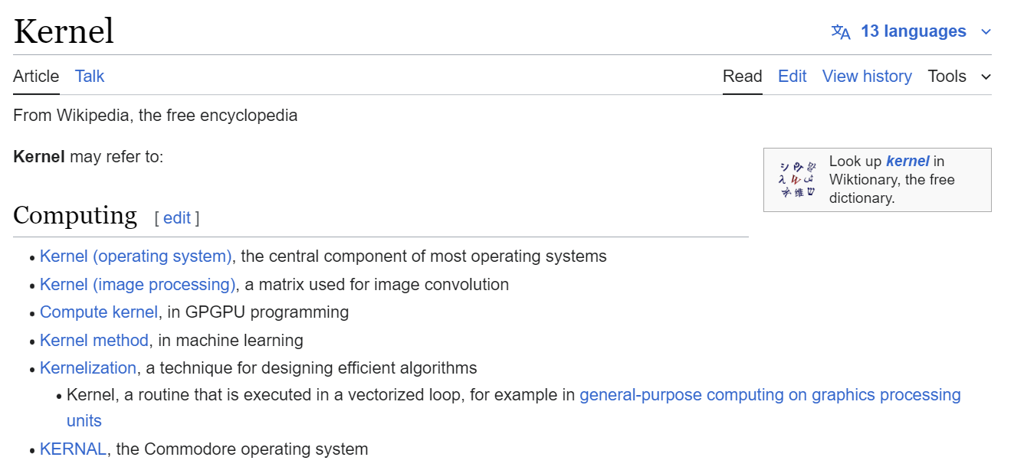
Wait, Didn’t We Learn About Kernels…?

Slide 39
One Hot Coded Dimension for Colour
1
3
5
7
8
10
13
2
4
6
9
11
12
Red
0
1
Blue
1

Slide 40
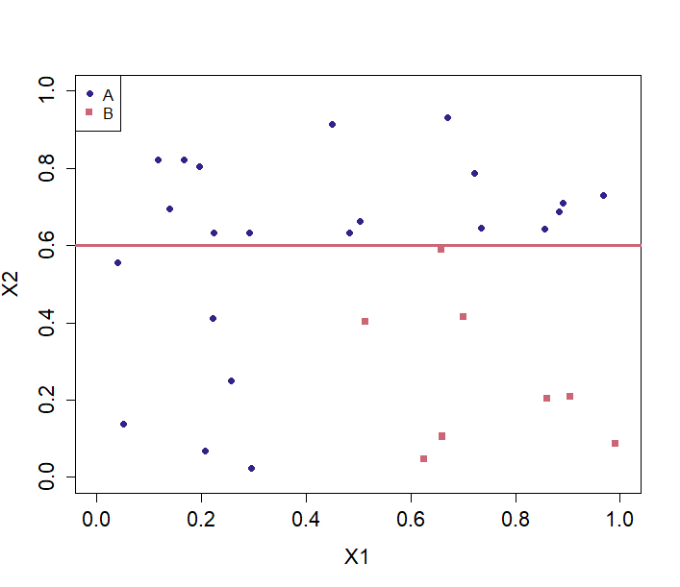
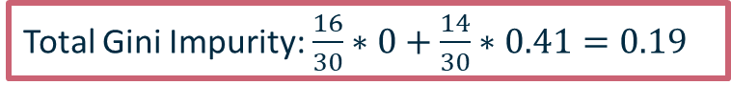
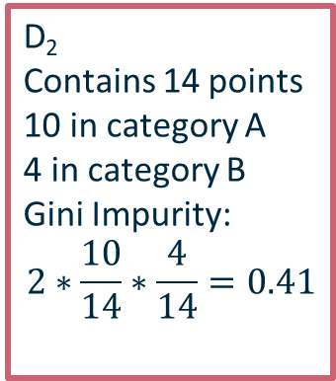
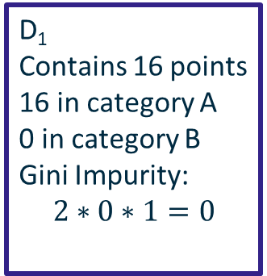
Binary Classification Tree
D₁
Contains 16 points
16 in category A
0 in category B
Gini Impurity:
$$2∗0∗1=0$$
D₂
Contains 14 points
10 in category A
4 in category B
Gini Impurity:
$$2∗\frac{10}{14}∗\frac{4}{14}=0.41$$
Total Gini Impurity: $\frac{16}{30}∗0+\frac{14}{30}∗0.41=0.19$

Slide 41
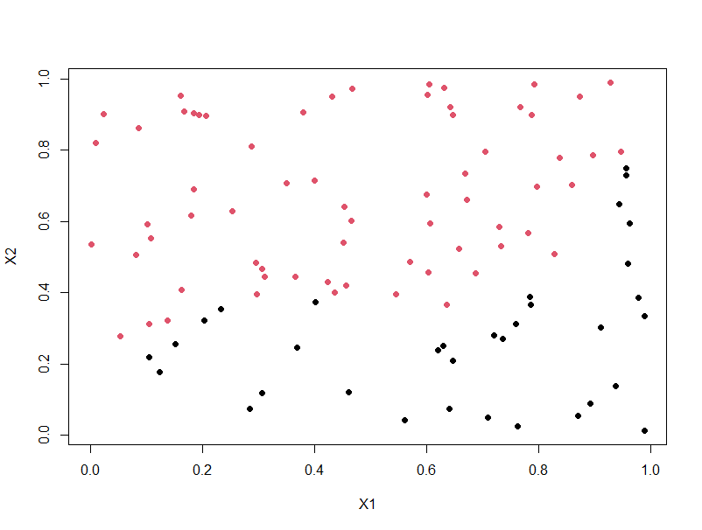
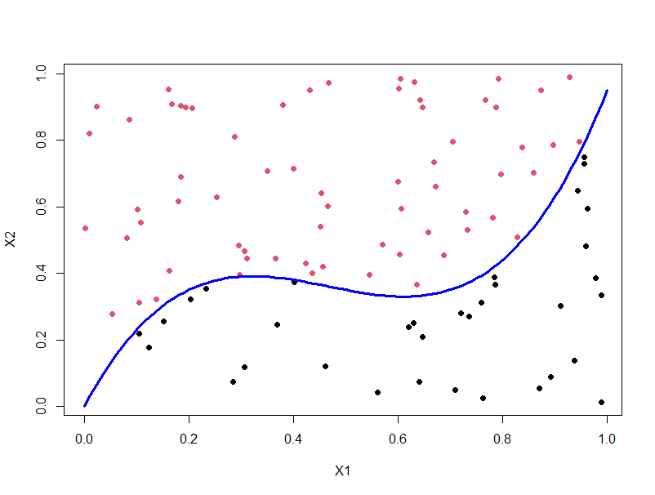
What Is The Kernel Trick?
Support Vector Machine (SVM) in 2 minutes – YouTube

Slide 42
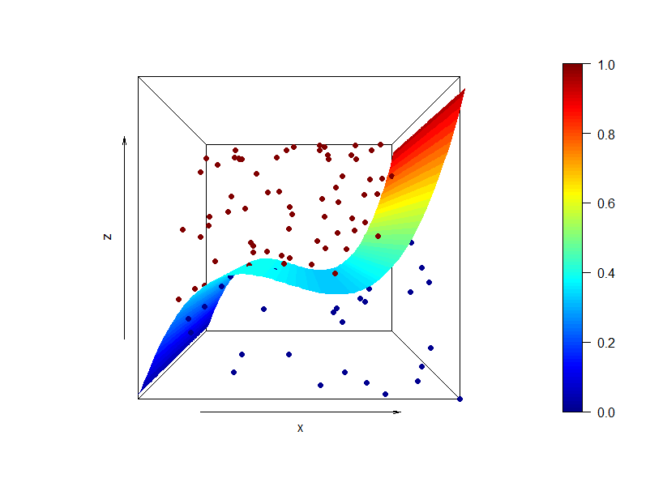
…it’s on a curved surface

Slide 43
The Kernel Trick: Find The Surface!
For more mathematical detail, please see Chapters 1-4 of Pattern Recognition by Theodoridis and Koutroumbas
Useful websites:
Support Vector Machines in R Tutorial | DataCamp
Support Vector Machine Simplified using R (listendata.com)
RPubs - Supervised Regression Model – SVM
Lab 15 - Support Vector Machines in R (smith.edu)
For today:
TOY DATA (see notebook on NCC server)
PUMPKIN SEEDS (Link 1) (Link 2)

